Slide 1
References According to APA 6th Ed. Style
CC – 11 : Research Methodology Paper
Semester – V (Hons.)
Dr. Kaustuv Mukherjee
Assistant Professor
Dept. of Geography
Chandidas Mahavidyalaya

Slide 2
What is APA?
APA is one of many referencing styles used in academic writing. APA stands for American Psychological Association. The Association outlines the style in the Publication manual of the American Psychological Association [APA] (6th ed.).
Why reference?
It is important (morally & legally) to acknowledge someone else’s ideas or words you have used. Academic writing encourages paraphrasing information you have researched and read. Paraphrasing means re-wording something you have read in to your own words. If you use someone else’s words or work and fail to acknowledge them – you may be accused of plagiarism and infringing copyright.
Referencing correctly enables the marker or reader of your assignment to locate the source of the information. They can verify the information or read further on the topic.

Slide 3
Journal Article
Two Authors:
Sekertekin, A., & Bonafoni, S. (2020). Sensitivity Analysis and Validation of Daytime and Nighttime Land Surface Temperature Retrievals from Landsat 8 Using Different Algorithms and Emissivity Models. Remote Sensing, 12, 2776: 1 – 27. Doi:10.3390/rs12172776
Surname, First letter of Name., & Surname, First letter of Name. (Year of Publication). Title of the research. Journal Name (in Italic), Volume (Issue), page no (20 – 31). DOI number or any link of the research.

Slide 4
Journal Article
More than two authors:
Mondal, A.K., Bairagya, S.D., Rahaman, S.O., Ghosh, S., & Khatun, N. (2018). Socio-economic study of Pelling, Sikkim. Journal of Environmental Management, 5(1): 36 – 47.
Single Author:
Khatun, A. (2016). Geographical Study of Birbhum District. Ecology and Environment, 5(2), 12-17.

Slide 5
Example
Author Name: Alexander R. O'Neill
Title: Evaluating high-altitude Ramsar wetlands in the Eastern Himalayas
Journal Name: Global Ecology and Conservation
Year: 2019
Vol.: 20
Article No.: e00715
Page No: 1 – 19.
Doi: https://doi.org/10.1016/j.gecco.2019.e00715
O'Neill, A. R. (2019). Evaluating high-altitude Ramsar wetlands in the Eastern Himalayas. Global Ecology and Conservation, 20, e00715, 1 – 19. https://doi.org/10.1016/j.gecco.2019.e00715

Slide 6
Book
Reference:
Census of India. (2011). District census handbook of Birbhum District. New Delhi, India: Author.
Citation: (Census of India, 2011).
Author Name: Savindra Singh
Book: Geomorphology
Publisher: Prayag Book House
Place: Allahabad, India.
Year: 2015
Page no: 70 – 85.
Singh, S. (2015). Geomorphology. Prayag Book House, Allahabad, India, pp. 70 – 85.
Citation: (Singh, 2015)

Slide 7
Book

Slide 9
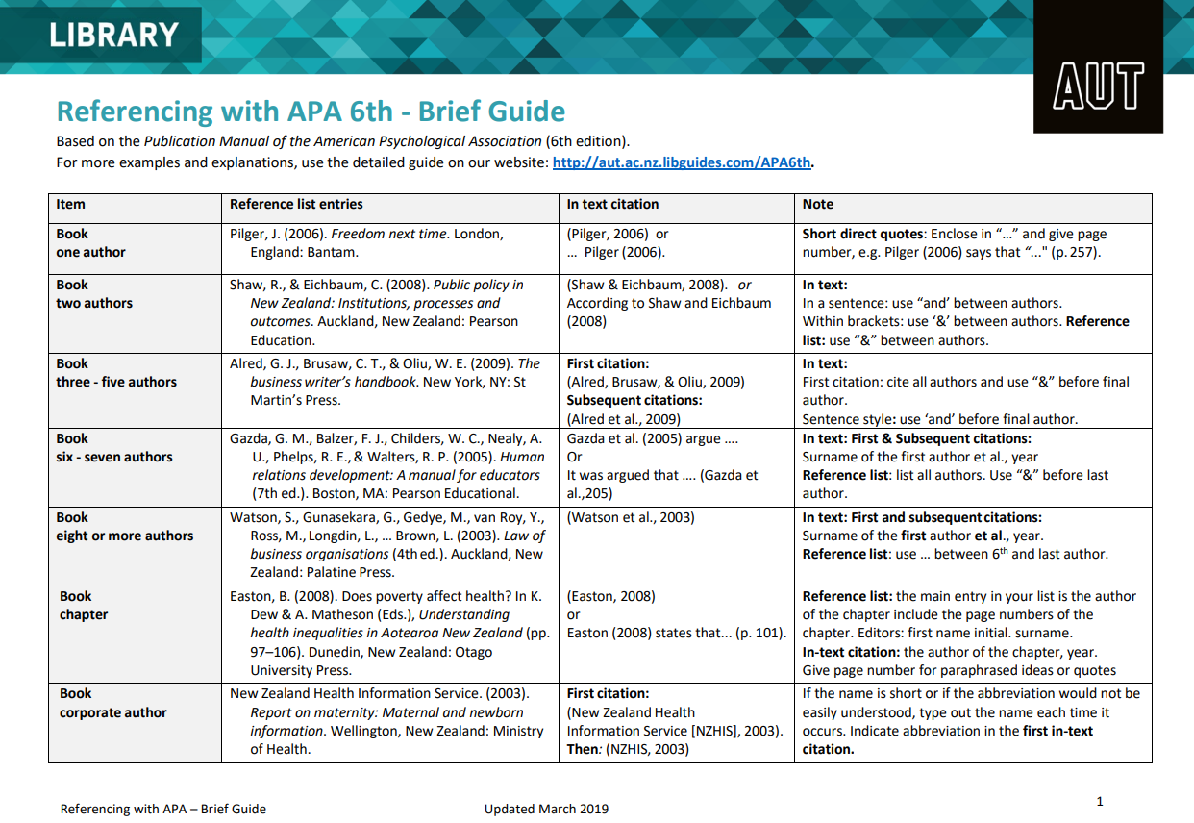
…continued
Source: http://aut.ac.nz.libguides.com/APA6th

Slide 10
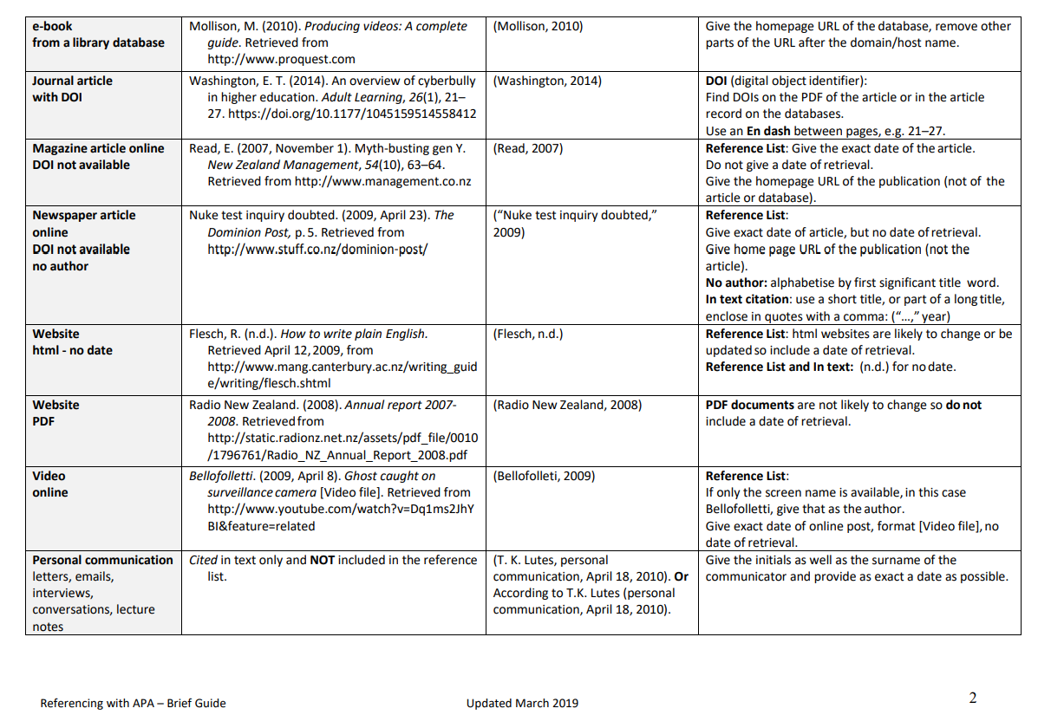
Source: http://aut.ac.nz.libguides.com/APA6th

Slide 11

THANK YOU

